Slide 1
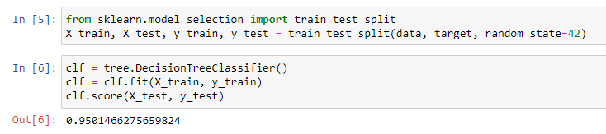
Used pandas to read the csv file
Used sklearn to import tree and score getting a 95%

Slide 2
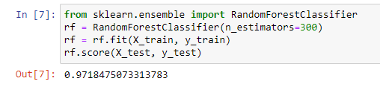
Use Random Forest Classifier and obtained 97.18% after trying with different number of estimators.

Slide 3
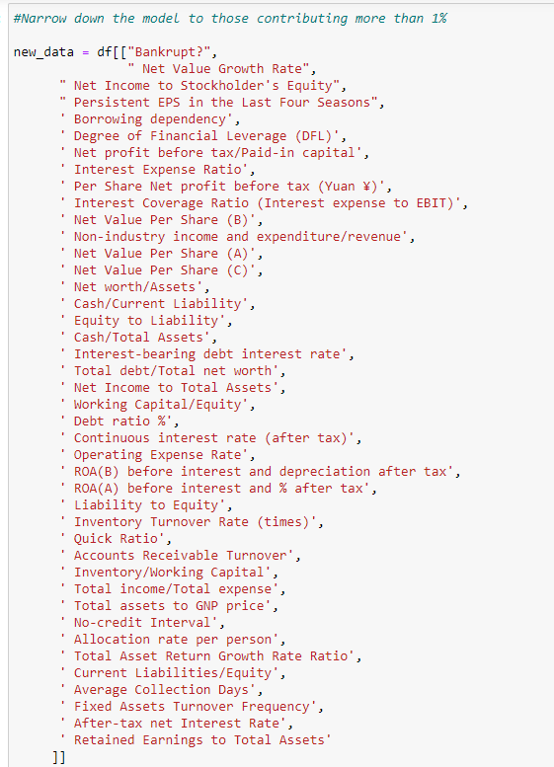
Originally had 95 different parameters to train. Decided to use feature importance to determine what parameters were important. Kept 41 parameter and removed anything contributing less than 1%.

Slide 4
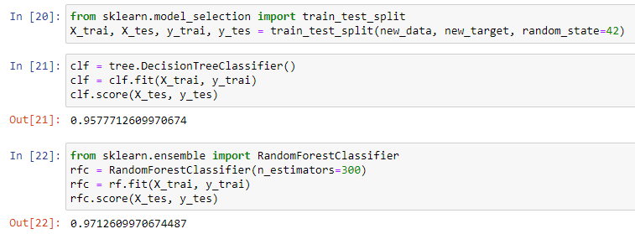
With fewer parameters we did not lose much accuracy

Slide 5
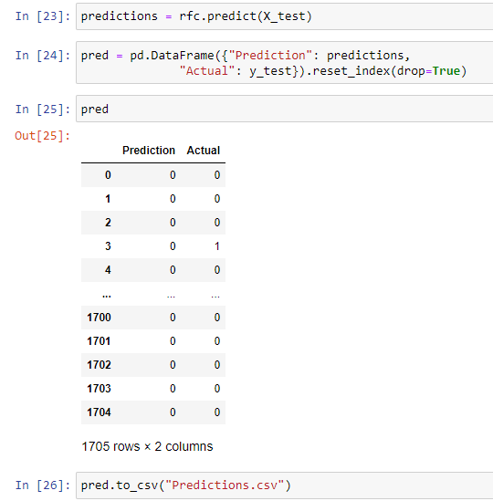
Ran prediction vs actual in data frame and exported to a csv to double check.

